Slide 1


0420
TRANSAMERICA COVID-19
UNDERWRITING UPDATES
PRESENTED by: Tom Corbin, Vice President Sales
& Bill Wysong, Chief Underwriter
254643
Not For Use With the Public. For Agent Use Only.
Notes:
Read slide

Slide 2

We ARE HERE FOR YOU
Implemented a work from home strategy for all employees
Donated $500,000 to Direct Relief
Providing thought leadership on market volatility
Established a COVID-19 Landing Page
Implemented competitive underwriting guidelines with increased non medical options.
Not For Use With the Public. For Agent Use Only.
Notes:
To help keep our employees safe and healthy, Transamerica implemented a Work from Home strategy for all employees
We also donated $500,000 to Direct Relief. Direct Relief, which provides protective gear to front-line health care workers who are putting themselves at risk every day. Direct Relief is an international organization, but we have asked that this donation be directed to the areas within the U.S. most in need of help in order to flatten the curve.
We established a COVID-19 Landing Page which include all of the information we are covering today.
We are regularly providing thought leadership on market volatility, available at this address
https://www.transamerica.com/lp/monitoring-the-markets/
And finally we have implemented very competitive temporary underwriting guidelines to better support agents and clients during this difficult time. We will now cover these new guidelines. Be aware that these guidelines will be in place until further notice.

Slide 3
EXPANDED NONMEDICAL LIMITS
Insureds thru age 55 &
Face amounts thru $1,000,000:
Products and Best Risk Class Available:
Transamerica Financial Foundation IUL®: Preferred/Tobacco
Trendsetter® Super & Trendsetter® LB : Standard Plus/Standard smoker
Lifetime Whole Life: Preferred/Tobacco
Updated Underwriting Guidelines:
Nonmedical Part II for Trendsetter Super & LB; long form app U327 for FFIUL; Part II Medical history questions for Lifetime Whole Life
The underwriter may order a PHI which includes a COVID-19 3 Question PHI (Lifetime Whole Life will include a reply to memo (RTM) in place of PHI) or other requirements
Long Term Care Rider & Living Benefit Riders are available and are subject to Underwriting
Not For Use With the Public. For Agent Use Only.
Add Proper Disclosure Here.
Notes:
Best Risk class available:
FFIUL & LWL = Preferred (nontobacco); if smoker rates apply, Tobacco is the best rate class available
Trendsetter Super/LB = Standard plus; if smoker rate apply, Standard smoker is the best rate class available
FFIUL – use long form app U327 – there is no filed nonmedical part II.

Slide 4
Temporary options for UW REQUIREMENTS
Insureds thru age 55 &
Face amounts thru $2,000,000:
Products and Best Risk Class Available:
Transamerica Financial Foundation IUL® : All risk classes available
Trendsetter® Super & Trendsetter® LB : All risk classes available
Lifetime Whole Life: All risk classes available
Updated Medical Requirements in lieu of traditional paramed and fluids:
Nonmedical Part II for Trendsetter Super & LB; long form app U327 for FFIUL; Part II Medical history questions for Lifetime Whole Life
AND one of the following:
Paramed exam/labs/labslip completed by other carriers within the last 12 months
PCP Exams/Labs completed within the last 12 months. Agent/insured must provide to Transamerica. The Underwriter will determine if the information received is sufficient to make an offer and at what rate class
Long Term Care Rider & Living Benefit Riders are available subject to Underwriting
Not For Use With the Public. For Agent Use Only.
Add Proper Disclosure Here.
Notes:
The part II medical questions will be called something different depending on what product you are looking at:
Trendsetter Super & LB = Nonmedical part II
FFIUL = Long form application U327
LWL = Part II Medical history questions
Other Carrier labs = Transamerica can obtain the labs with a copy of the lab slip.
PCP exams/labs (TA will not order an APS to obtain this information) – UW will determine if there is enough information to provide an offer and at what rate class. Keep in mind that there is no single standard set of lab test that an MD will order…so our ability to offer is dependent on the information received.

Slide 5
Transamerica Lifetime WL
For Transamerica Lifetime cases:
Normal Non-medical guidelines are still in place for Transamerica Lifetime.
Please follow the normal process since the majority of these cases are currently being approved without the need for a paramedical exam and labs.
The temporary underwriting guidelines can be used for the small number of cases that require an exam and labs.
Ages 56-75: Living Benefits Riders not currently available
Initial Age And Amount Requirements
15 days – 17 years
18 – 45
46 – 55
56 – 65
66 – 75
$25,000 – $499,999
Medical History³ Questions
Medical History³ Questions
Medical History³ Questions
Medical History³ Questions
Teleinterview⁴ Completes Part II BCP HOS Vitals
$500,000 – $999,999
Medical History³ Questions
Medical History³ Questions
Medical History³ Questions
Teleinterview⁴ Completes Part II BCP HOS Vitals
Teleinterview⁴ Completes Part II BCP HOS Vitals
$1,000,000 – $1,999,999
N/A
Medical History³ Questions
Teleinterview⁴ Completes Part II BCP HOS Vitals
Teleinterview⁴ Completes Part II BCP HOS Vitals
Teleinterview⁴ Completes Part II BCP HOS Vitals
$2,000,000
N/A
Teleinterview⁴ Completes
Part II BCP HOS Vitals
Teleinterview⁴ Completes Part II BCP HOS Vitals
Teleinterview⁴ Completes Part II BCP HOS Vitals
Teleinterview⁴ Completes Part II BCP HOS Vitals
¹ Juveniles (0-17) not eligible for International Underwriting
² International Underwriting ineligible for straight through and fluidless processing
³ Agent completes the medical questions with the consumer
Vendor asks medical history questions over the phone with consumer
Transamerica reserves the right to request other evidence of insurability as it deems necessary
Note: Nonmed is only available to residents of the United States and Puerto Rico. Nonmedical application (Part 2) and HIPAA notice required for all nonmed business
May be eligible for fluidless acceleration^{1,2}
Traditional requirements
Not For Use With the Public. For Agent Use Only.
Add Proper Disclosure Here.
Notes:
Nothing is changing with the Lifetime WL and don’t change what you’re doing today unless there is a requirement for labs.

Slide 6
UW requirements
Insureds ages 56 thru 75 & all face amounts:
Products and Best Risk Class Available:
Transamerica Financial Foundation IUL®: All risk classes available
Trendsetter® Super: All risk classes available
Lifetime Whole Life: All risk classes available
Updated Underwriting Guidelines:
Traditional Underwriting - Normal age and amount requirements will continue to be required
Rated over Table B for the following conditions (Cardiac, Cancer, Respiratory, Hypertension, Diabetes) and will require referral to our Medical department for consideration
Long Term Care Rider & Living Benefit Riders not currently available
Insureds thru age 75 on traditionally nonmedical face amounts*:
Updated Underwriting Guidelines:
No Changes to initial underwriting requirements
Ages 56-75: Long Term Care Rider and Living Benefits Riders not currently available
Not For Use With the Public. For Agent Use Only.
Add Proper Disclosure Here.
* Varies by age and product
Notes:
Read slide

Slide 7
ADDITIONAL GUIDELINES
Insureds over age 75 at all face amounts:
Updated Underwriting Guidelines:
We are not currently accepting applications for proposed insureds over age 75
Please do not submit these cases
Insureds thru age 75 and face amounts over $2,000,000 :
Normal age and amount requirements will continue to be required .
Juvenile guidelines will remain the same
Non-Med POS/ FastTrack will remain the same.
Not For Use With the Public. For Agent Use Only.
Notes:
Cases in house on individuals over age 75 – we will let those play out.

Slide 8

APPLICATION PART II
With no Paramed or Fluids, the Part II is critical
You are the field underwriter!
Choose “Full” Application on iGo and complete Part I & Part II
Not available with Express app
Ensuring the Part II is completed accurately and matches the data, will help expedite the process
Data that doesn’t align, may require additional requirements
Add Proper Disclosure Here.
8
Not For Use With the Public. For Agent Use Only.
Notes:
Read slide

Slide 9
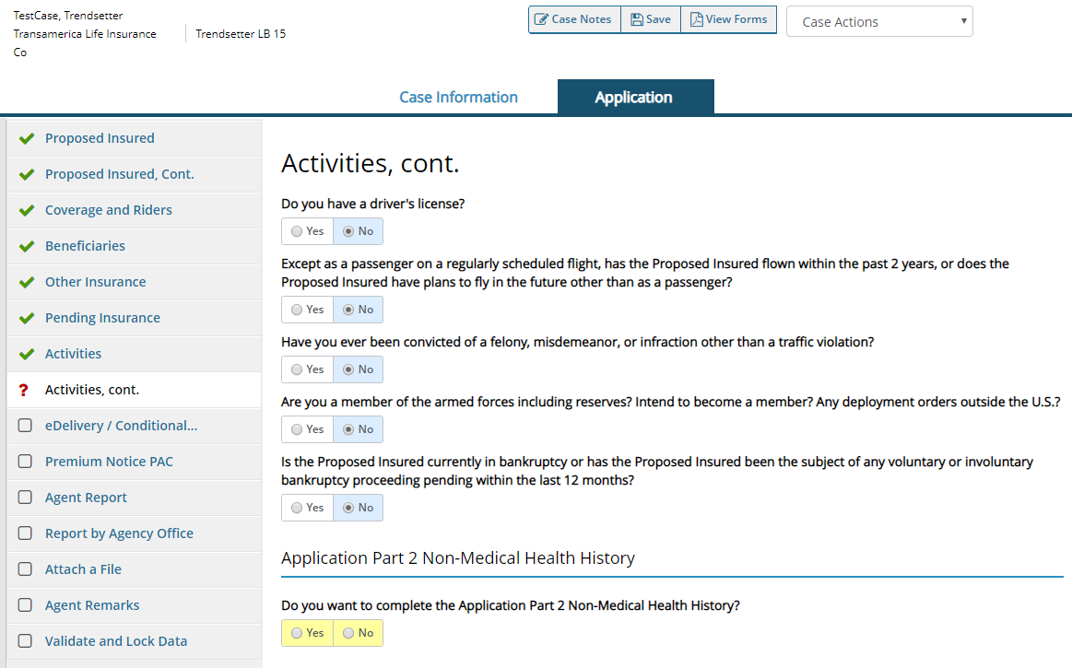
iGO and PART II – TERM
Not For Use With the Public. For Agent Use Only.
Add Proper Disclosure Here.
Notes:
Read slide

Slide 10
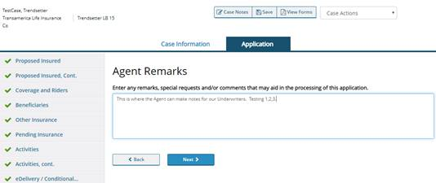
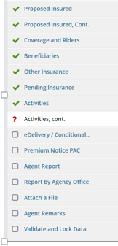
iGO and PART II – TERM
NON MED UNDERWRITING PROCESSES REQUESTED
Not For Use With the Public. For Agent Use Only.
Add Proper Disclosure Here.
Notes:
Read slide

Slide 11
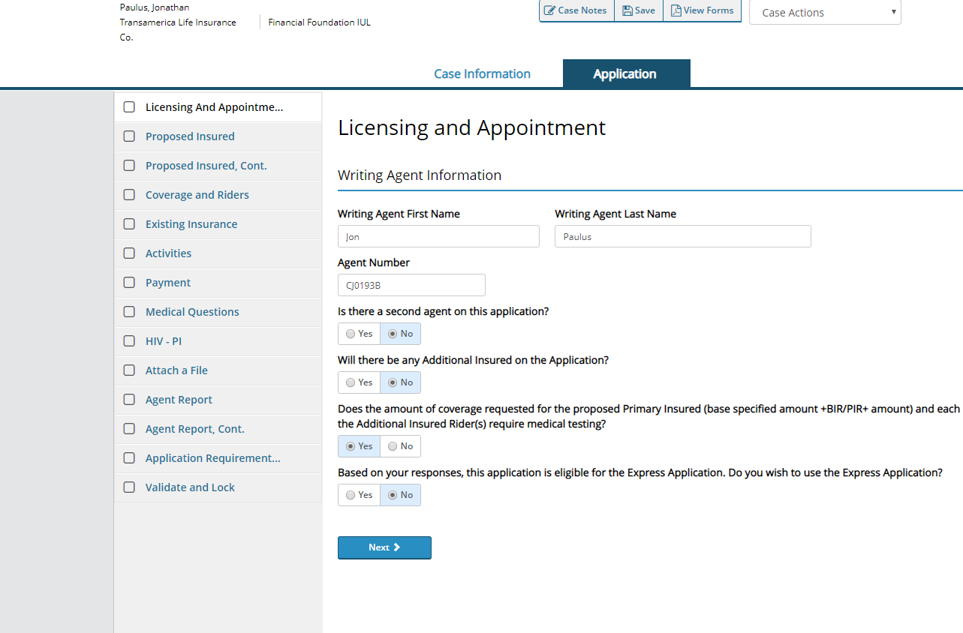
iGO and NONMED– FFIUL
Not For Use With the Public. For Agent Use Only.
Notes:
Select No to Express application section

Slide 12
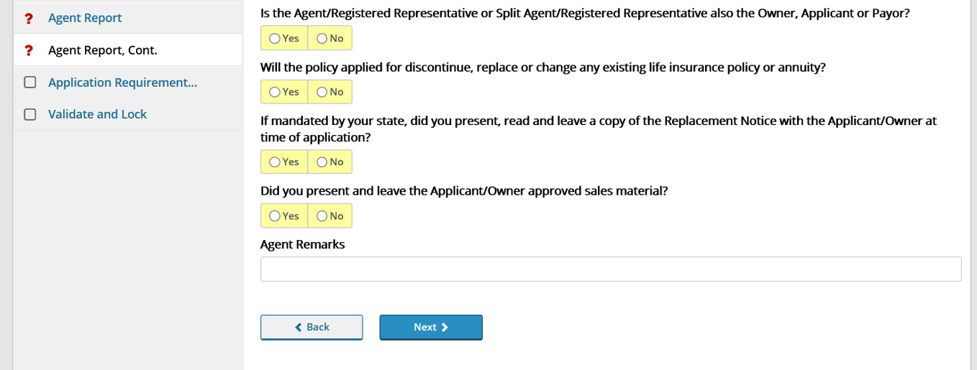
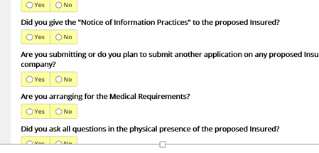
iGO and NONMED– FFIUL
NON MED UNDERWRITING PROCESSES REQUESTED
Not For Use With the Public. For Agent Use Only.
Notes:
Select No to Express application section

Slide 13
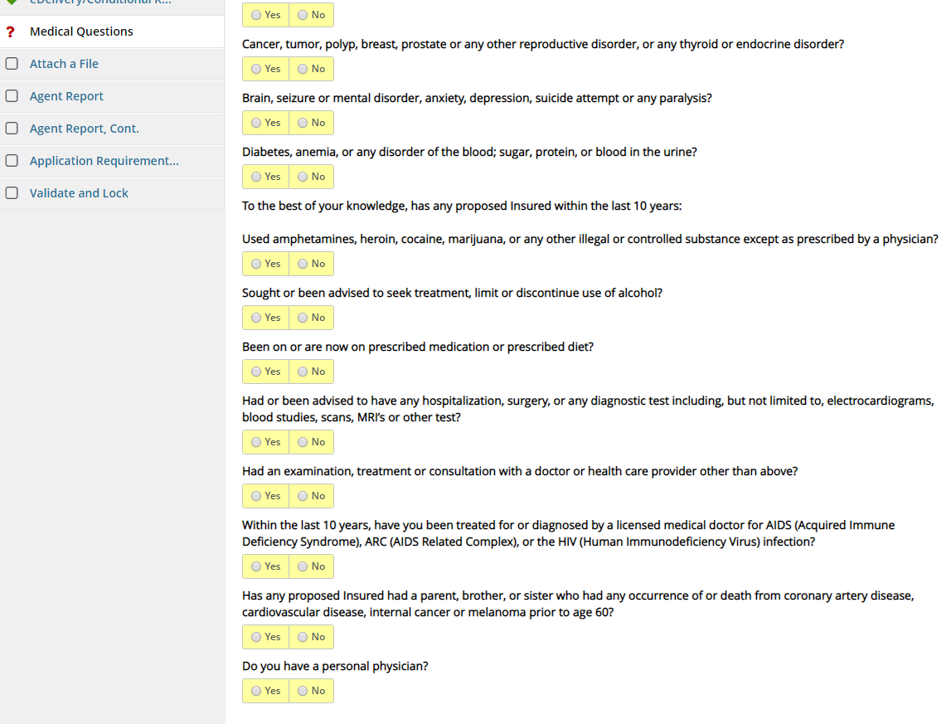
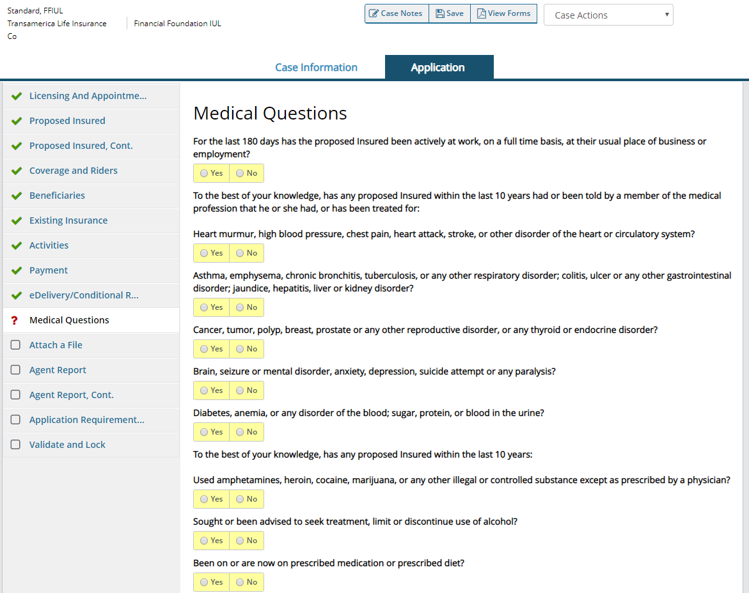
iGO and NON MED– FFIUL
Not For Use With the Public. For Agent Use Only.
Notes:
Then under the Medical Questions, ensure are questions are answered accurately.

Slide 14

AVAILABLE RESOURCES
Transamerica COVID-19 Insurance Landing Page – see email for link to landing page
Monitoring the Markets - https://www.transamerica.com/lp/monitoring-the-markets/
A message from our President and CEO – http://transmerica.com
Not For Use With the Public. For Agent Use Only.
Notes:
Read slide

Slide 15

04/20
THANK YOU
Transamerica and its representatives do not give tax or legal advice. This material and the concepts presented here are for informational purposes only and should not be construed as tax or legal advice.
254643
© 2020 Transamerica

